Slide 1
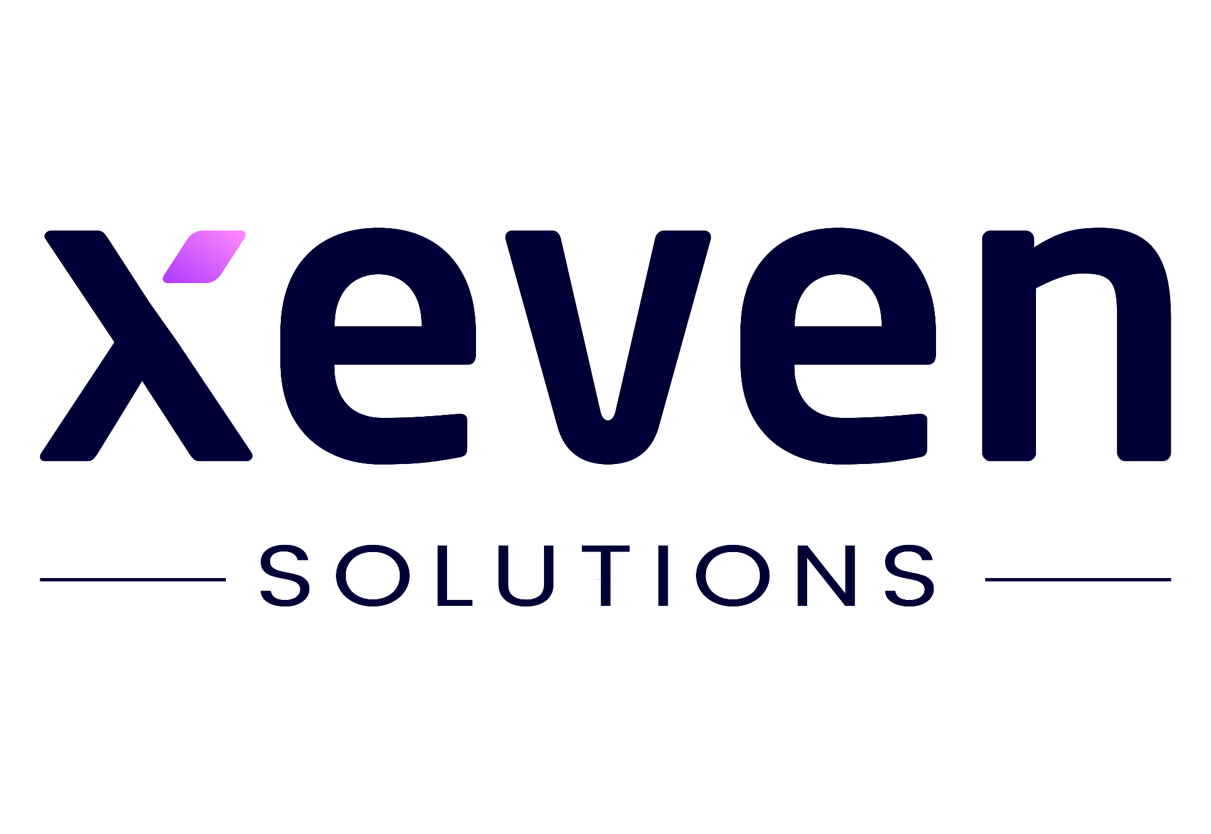

Lecture 04
Irfan Malik
Dr. Sheraz Naseer

Slide 2
Agenda
Recap
Generative AI
LLM vs Diffusion Models
Prompting

Slide 3
Previous lecture:
Lecture 03 - Deep Learning
Click Here

Slide 4
Recap

Slide 5
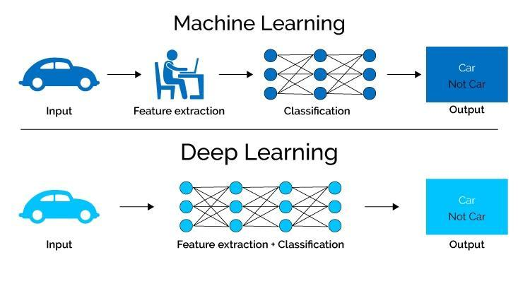
Deep Learning
Deep learning simulates our brain, helping systems learn to identify object and perform complex task with increasing accuracy without human intervention
(as required by machine learning).

Slide 6
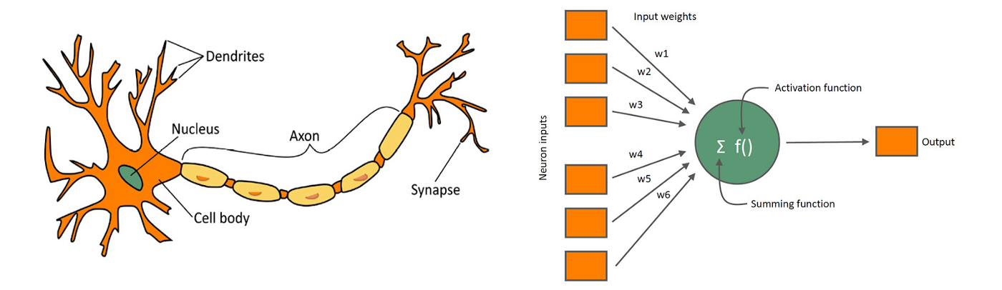
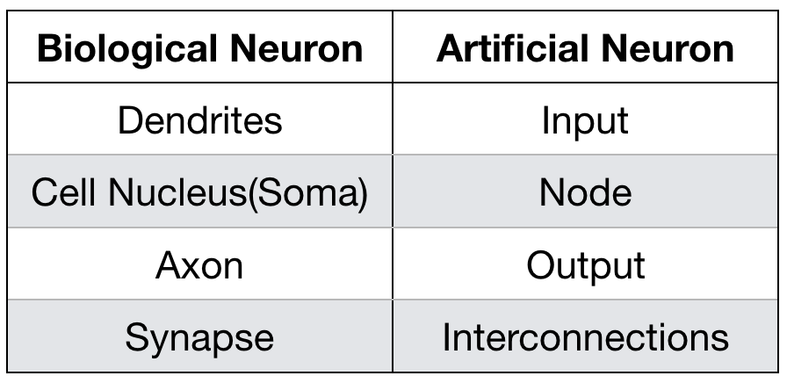
Biological Neuron
Artificial Neuron

Slide 7

Neural Network

Slide 8
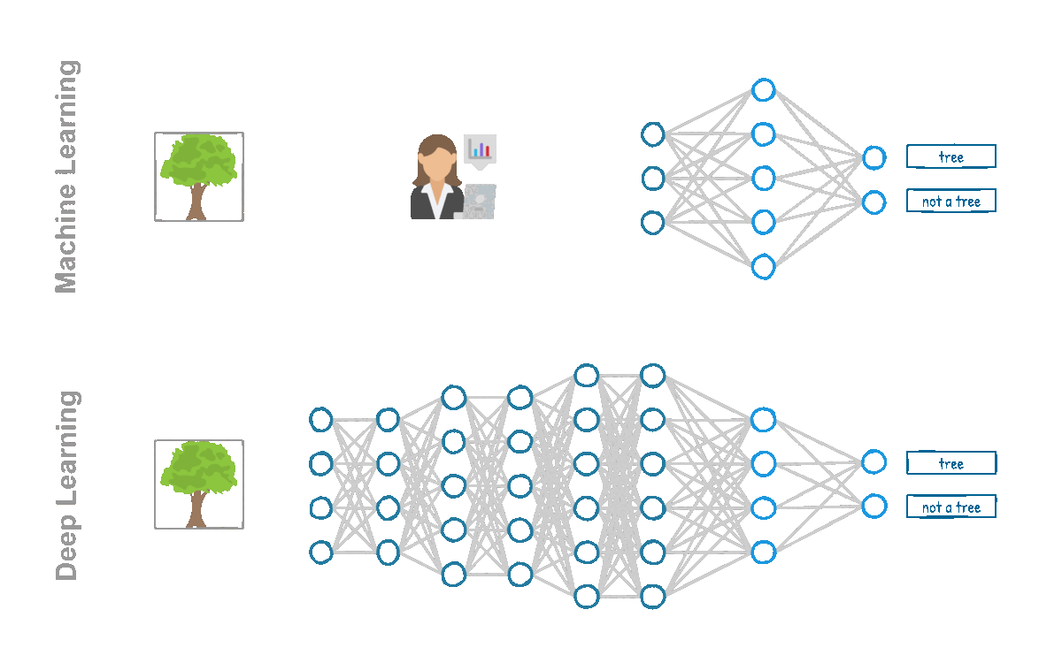
ML vs. DL

Slide 9
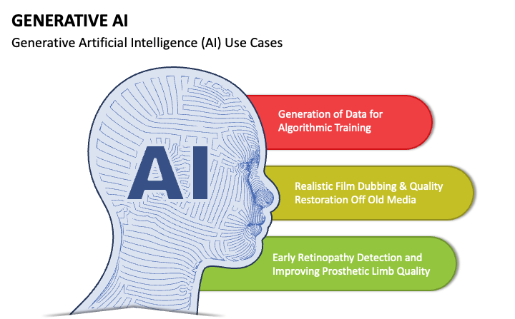
Generative AI
Generative AI, also known as GenAI is a type of artificial intelligence that creates new content based on the patterns learned from existing data .These algorithms can generate text, images, videos, audio, code etc.

Slide 10
Generative AI
Text Generation
ChatGPT 3.5/4
Bard
Image generation
Dall-E3
Stable Diffusion
Music Generation
Music-LM
Video Generation
Runway ML Gen-2

Slide 11
Discriminative AI Generative AI
Discriminative AI represents a specialized area in Artificial intelligence focused on distinguishing different types of data input. Unlike Generative AI, discriminative AI relies on existing data, identifying and categorizing it based on learned patterns.
Generative Artificial Intelligence , also known as GAI refers to AI systems capable of generating text ,images or other data in response to inputted prompt. These systems learn from existing data and then create new content that shares similar characteristics with training data.

Slide 12
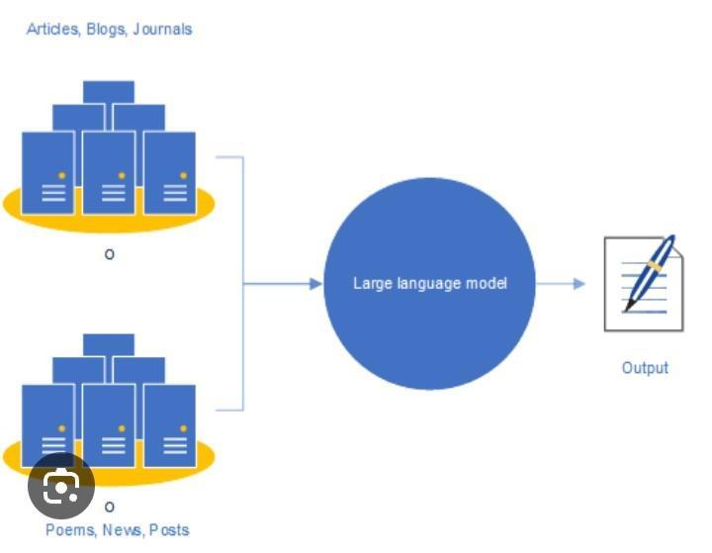
Large Language Models(LLMs)
Large Language Model refers to large, general purpose language models that can be pre-trained and then fine-tuned for specific purposes.

Slide 13
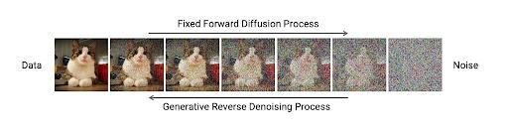
Diffusion Models
Diffusion models are advanced machine learning algorithms that uniquely generate high-quality data by progressively adding noise to a dataset and then learning to reverse the process.

Slide 14
LLMs
LLMs can perform various natural language tasks without fine-tuning or task-specific training.
LLMs work with natural language data, such as text and sentences.
LLMs generate coherent and relevant text output given any prompt.
Diffusion Models
Diffusion models are specialized in image generation tasks, transforming noise into realistic and diverse images.
Diffusion models operate on image data, learning appearance and variation from large datasets.
Diffusion model produce realistic and multifaceted images by reversing a diffusion process.

Slide 15
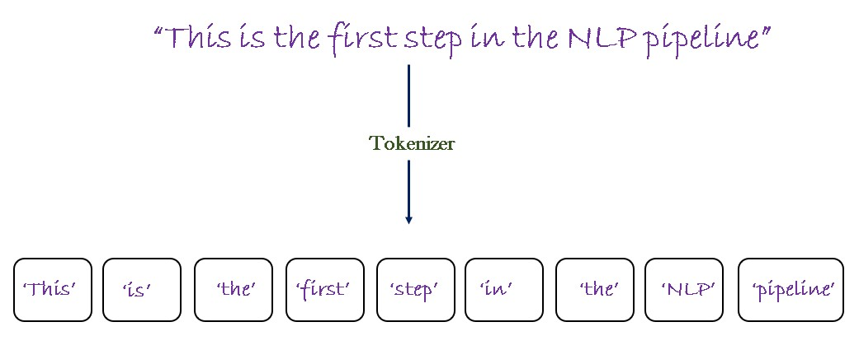
Tokenization
Definition: Tokenization is the process of breaking down text into smaller units called tokens, which can be words, phrases, or even characters.

Slide 16
Tokens in Language Models
Definition: Tokens are the fundamental units of text used by language models. They can be as short as a single character or as long as a word or phrase.
Importance: Language models process text at the token level, allowing them to analyze and generate text based on the context and relationships between individual tokens.

Slide 17
What is the context window of LLMs?
Context window is a textual range around the target token that a Large Language Model(LLM) can process at the time information is generated.
Context window of:
GPT-3 is 32K tokens
GPT-3.5-TURBO is tokens
GPT-4 is 4096 tokens
Bard is 1K tokens(by 17th Nov,2023)
Gemini is 128K token

Slide 18
Prompt Engineering

Slide 19
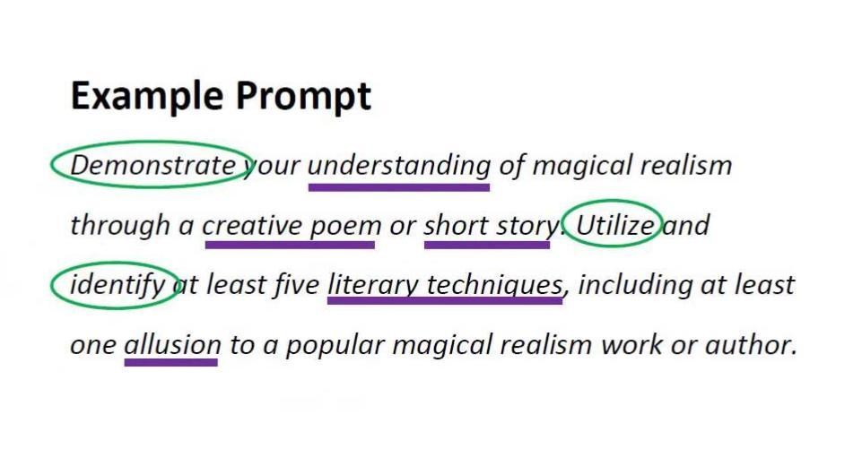
What is a prompt?
A prompt is a short piece of text that is given to large language model as input and it can be used to control the output of the model in many ways.

Slide 20
What is Prompt Engineering?
Prompt engineering involves crafting tailored instructions or queries to guide the language model towards desired outputs.
It helps shape the behavior of the model and improves response quality.

Slide 21
Anatomy of Prompt
Definition: In the context of language models, a prompt refers to the input or instruction provided to the model to generate a specific response or output
Parts of a Good Prompt (Not all are necessary for each and every prompt. )
1- Simulate Persona
2- Task
3- Steps to complete Task
4- Context/Constraints
5- Goal
6- Format Output

Slide 22
Week Summary
Deep Learning
Neural Networks
Generative AI
Discriminative vs Generative AI
Tokens
Context Window

Slide 23
Next Lecture:
Lecture 05 - Prompt Engineering
Click Here

